Slide 1
Hospital Performance Analysis– Lowell General Hospital
Healthcare Domain

Slide 2
Problem Statement
Lowell General Hospital focuses on patient care and operational efficiency.
However, variations in Bed Occupancy, Staff Responsiveness, and Unassisted Fall Rate may impact patient experience.
Hence, an analysis was done to study performance trends and find improvement areas.

Slide 3
Problem Objective
Analyze 3 key metrics:
  Average Bed Occupancy Rate
  Staff Responsiveness
  Unassisted Fall Rate
Study relationships between KPIs
Compare results against benchmarks
Suggest improvement actions based on insights

Slide 4
Dataset Overview
Size: (60, 5)
Key Variables:
Month
Average Licensed Bed Occupancy Rate
Unassisted Fall Rate per 1,000 Patient Days
Staff Responsiveness Domain Top Box Score
Staff Responsiveness Top Box Score Benchmark

Slide 5
Understanding KPIs
Bed Occupancy Rate
Number of Patients in Licensed Beds per Day/ Number of Licensed Beds * 100
Meaning- % of hospital beds occupied
Importance- Shows how efficiently hospital beds are used

Slide 6
Understanding KPIs
Staff Responsiveness
Number of patients answering "Always" to the two Staff Responsiveness questions/ Number of patients answering the two Staff Responsiveness questions * 100
Two questions are: During this hospital stay, after you pressed the call button, how often did you get help as soon as you wanted it? How often did you get help in getting to the bathroom or in using a bedpan as soon as you wanted?
Meaning- % of positive feedback for staff response time
Importance- Indicates quality of patient support

Slide 7
Understanding KPIs
Unassisted Fall Rate
Number of Patient Falls/ Number of Patient Days * 1000
Meaning- Falls per 1,000 patient days
Importance- Reflects patient safety and care standards

Slide 8
Data analysis process
1️⃣ Data Cleaning: Removed duplicates, corrected formats
2️⃣ KPI Calculation: Average of each KPI by year/month
3️⃣ Trend Analysis: Visualized patterns using Excel & Power BI
4️⃣ Benchmark Comparison: Compared with U.S. averages
5️⃣ Correlation Analysis: Studied KPI relationships

Slide 9
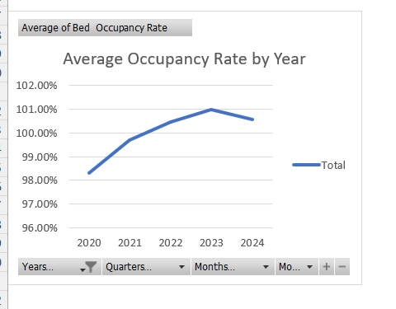
KPI Trends (Pivot analysis)
Insights:
Bed Occupancy: Constantly high (~98–100%) - strong demand but may lead to pressure on staff.

Slide 10
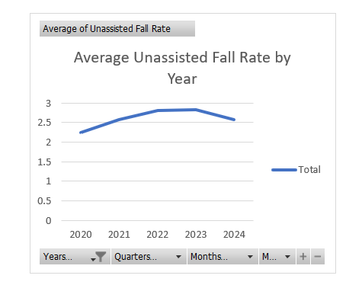
KPI Trends (Pivot analysis)
Insights:
Unassisted Fall Rate: Slight increase during high occupancy - indicates patient safety risk.

Slide 11
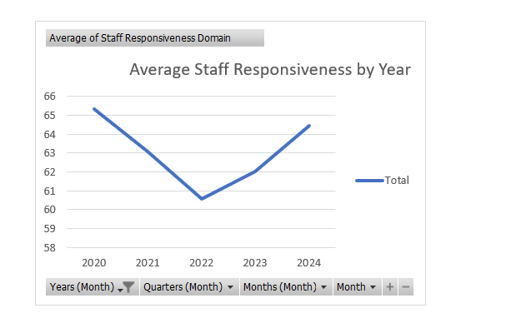
KPI Trends (Pivot analysis)
Insights:
Staff Responsiveness: Dip during high occupancy - potential strain on workforce.

Slide 12
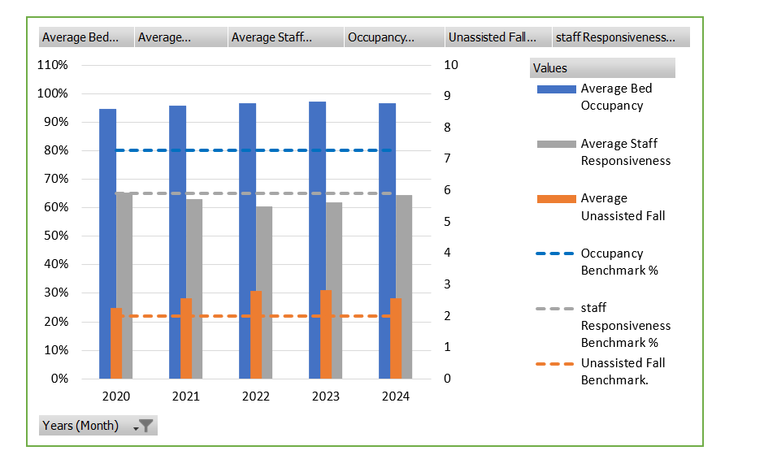
KPI vs Benchmark
Bed Occupancy
LG Hospital- 97, Benchmark- 80
Insight- Very high utilization, may cause overwork risk
Fall Rate
LG Hospital- 2.5, Benchmark- 2.0
Insight- Higher than Benchmark, continue monitoring and strengthening fall prevention
Staff Responsiveness
LG Hospital- 64.45, Benchmark- 65
Insight- Below standard, staffing or training issues

Slide 13
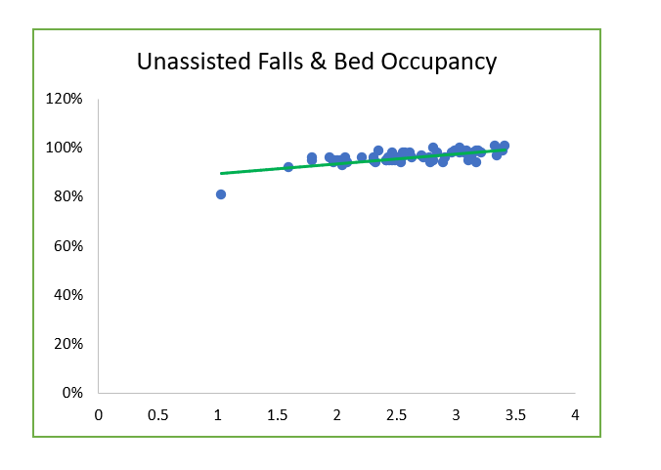
Correlation analysis
Relationship with KPIs
Bed Occupancy and Fall Rate: +0.70
Strong Positive
More occupancy means more falls.

Slide 14
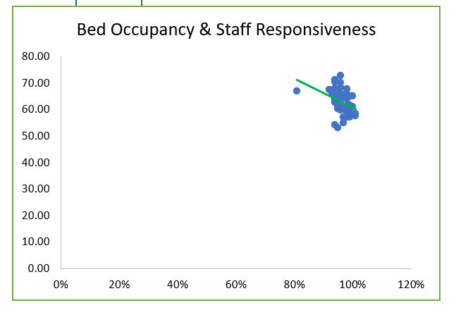
Correlation analysis
Relationship with KPIs
Bed Occupancy and Staff Responsiveness:
-0.37
Moderate Negative
Higher occupancy means slower staff response.

Slide 15
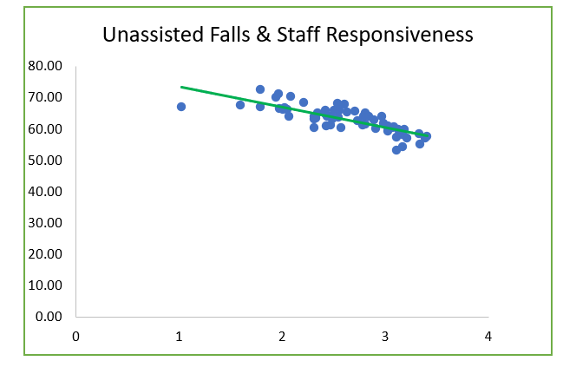
Correlation analysis
Relationship with KPIs
Fall Rate and Staff Responsiveness:
-0.79
Strong Negative
Better responsiveness means fewer falls.

Slide 16
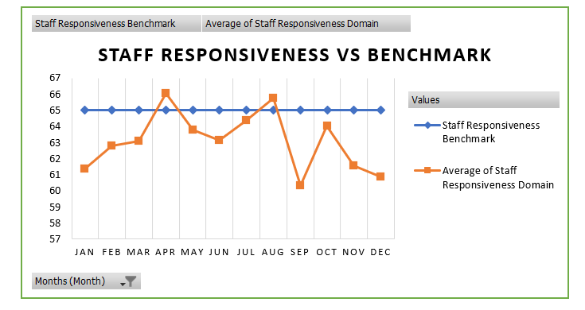
Staff Responsiveness Comparison Analysis

Slide 17
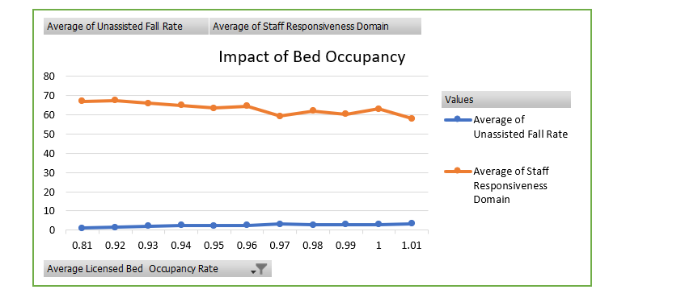
KPI vs Occupancy

Slide 18
Findings
High bed occupancy maintained throughout years.
Staff responsiveness slightly below benchmark.
High occupancy directly affects responsiveness and safety

Slide 19
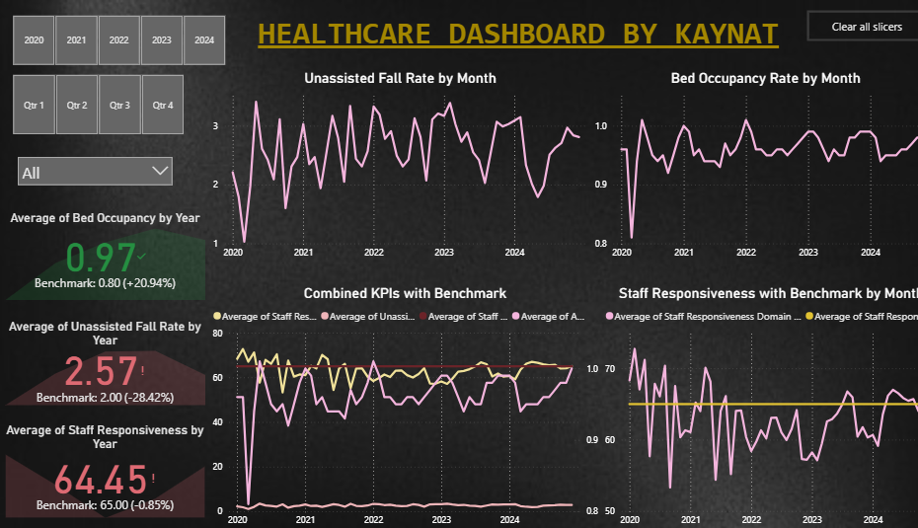
Dashboard

Slide 20
Recommendations
Optimize Staff-Patient Ratio: Balance workload during high occupancy periods.
Improve Staff Responsiveness: Regular training & digital alerts to improve speed of response.
Monitor Occupancy Patterns: Use predictive tools to forecast staffing needs.
Enhance Patient Safety Programs: Regular checks to minimize unassisted falls.

Slide 21
Thank You!

